Slide 1
IIITH Technology Product Entrepreneurship: Segmentation
If you’re not thinking segments, you’re not thinking. To think segments means you have to think about what drives customers, customer groups, and the choices that are or might be available to them.
—Levitt, Marketing Imagination

Slide 2
Mass-marketing
A strategy that presumes there is one undifferentiated market and that one product will appeal to all consumers in that market.
Notes:
What is “mass marketing?”
Examples of mass-marketed products?
The Model-T Ford, which was offered “in any color they wanted, as long as it was black.”
Coca-Cola (before the classic coke fiasco, and now “cherry coke” etc.)

Slide 3
Advantages
Lower cost
One advertising campaign is needed
One marketing strategy is developed
Usually only one standardized product is developed
Disadvantage
It only works if all consumers have the same needs, wants, desires, and the same background, education and experience
Notes:
What huge advantage does it have over other types of marketing?

Slide 4
Market Matching Strategy
Today, mass marketing has largely been replaced by a three-step market matching strategy
Segmentation
Act of dissecting the marketplace into submarkets that require different marketing mixes
Targeting
Process of reviewing market segments and deciding which one(s) to pursue
Positioning
Establishing a differentiating image for a product or service in relation to its competition
Notes:
Let’s look briefly at all three before going into detail on each;
What is segmentation?
What is targeting?
What is positioning?
Let’s look at each of these in more detail…

Slide 5
Market Segmentation
Market segmentation is the subdividing of a market into distinct subsets of customers.
Segments
Members are different between segments but similar within.
……………..and selecting one or more to target with a distinct marketing mix
Notes:
2
2

Slide 6
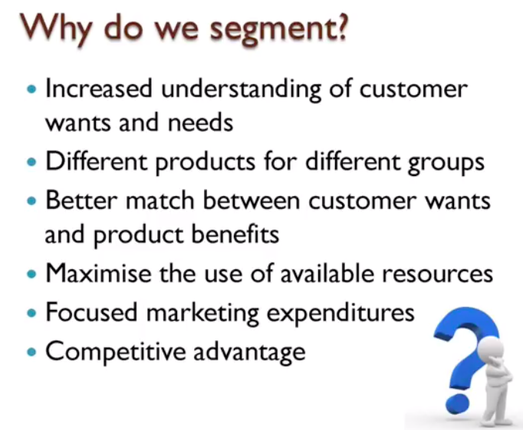

Slide 7
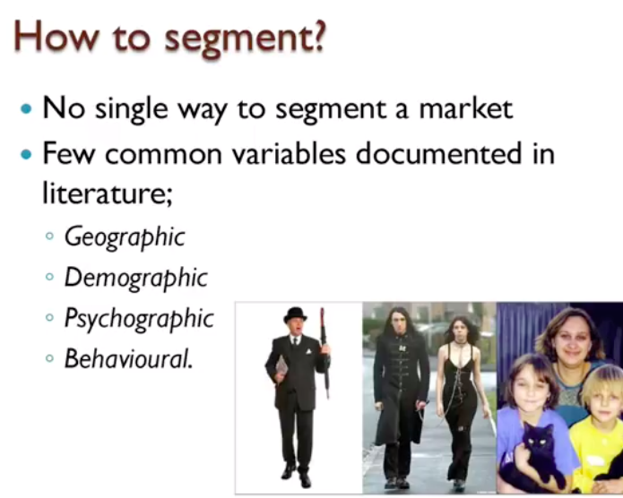
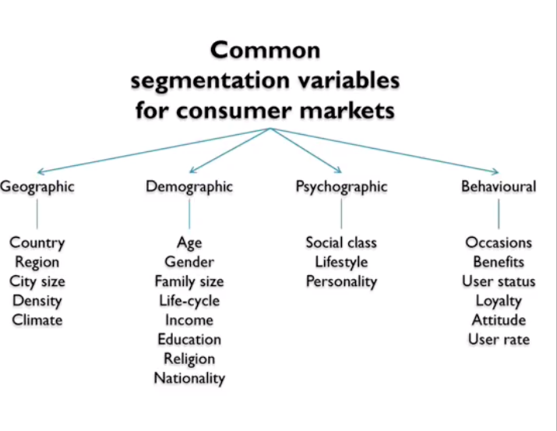

Slide 8
Geographic Segmentation
Division of the market based on the location of the target market
People living in the same area have similar needs and wants that differ from those living in other areas
Climate
Population density
Notes:
What is it?
What is the theory behind it?
Examples?
Climate: snowblowers/Subaru Outbacks vs. sunscreen/convertibles
Population Density: lawn mowers/gas grills vs. small appliances/convertible sofas
Taste: mild salsa sells best in the northeast while hot salsa is preferred in the west
A concept related to this issue is Micromarketing:
What is it?
Campbell Soup segments its domestic market into 20 different segments; each regional sales office has its own budget and authority to develop specific advertising and promotional campaigns geared to local market needs and conditions

Slide 9
Demographic Segmentation
Partitioning of the market based on factors such as
age
gender
marital status
income
occupation
education
ethnicity
Notes:
What is it?
Let’s look at some of these demographic variables…

Slide 10
Psychographic Segmentation
Partitioning of the market based on lifestyle and personality characteristics
Marketers use it to further refine a target market
Its appeal lies in the vivid and practical profiles of consumer segments that it can produce
Notes:
What is it?

Slide 11
Behavioral Segmentation
Partitioning of the market based on attitudes toward or reactions to a product
Behavioral segmentation can be done on the basis of:
Usage rate
Benefits sought from a product
Notes:
Another segmentation variable is…
What is it?

Slide 12
1. Usage Rate
Differentiates between
heavy users
medium users
light users
nonusers
In general, a relatively small number of heavy users account for a disproportionately large percentage of product usage
Targeting those heavy users is a common marketing strategy
Notes:
Why is this important? Because… (heavy users)
For example, 25-35% of beer drinkers account for 70% of consumption

Slide 13
2. Benefit Segmentation
Marketers constantly attempt to identify the single most important benefit of their product that will be the most meaningful to consumers
Changing lifestyles play a major role in determining the product benefits that are important to consumers and also provide marketers with opportunities for new products and services
Notes:
For example, microwave ovens for the dual-income family (speed and convenience)
Financial Security (Met Life)
Comfort (Bausch & Lomb disposable contact lenses)
Good health (egg beaters egg substitute)
Backache relief (Advil, etc.)

Slide 14
Consumer Industrial
Descriptors Age, income, marital status, Industry, size, location, current Demographics family type & size, supplier(s), technology utilization, gender, social class, etc. etc.
Psychographics Lifestyle, values, & Personality characteristics of personality characteristics. decision makers.
Behavior Use occasions, usage level, Use occasions, usage level, complementary & complementary & substitute substitute products used, products used, brand loyalty, order brand loyalty, etc. size, applications, etc.
Decision Making Individual or group Formalization of purchasing (family) choice, low or high procedures, size & characteristics involvement purchase, of decision making group, use of attitudes and knowledge outside consultants, purchasing about product class, price criteria, (de) centralizing buying, sensitivity, etc. price sensitivity, switching costs, etc.
Notes:
8
8

Slide 15
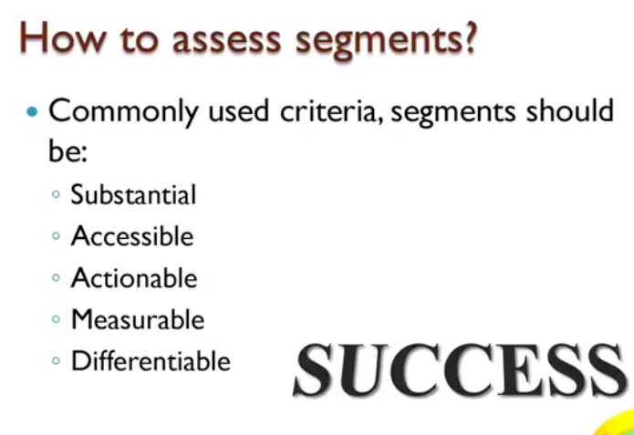

Slide 16
Choosing Market Segments to Target
Once an organization has identified its most promising market segments, it must decide whether to target one segment or several segments
Each targeted segment will then receive a specially designed marketing mix — i.e., a specially tailored product, price, distribution network and/or promotional campaign
Notes:
OK, now we know what market segments are out there, the next step is to decide which to “target”

Slide 17
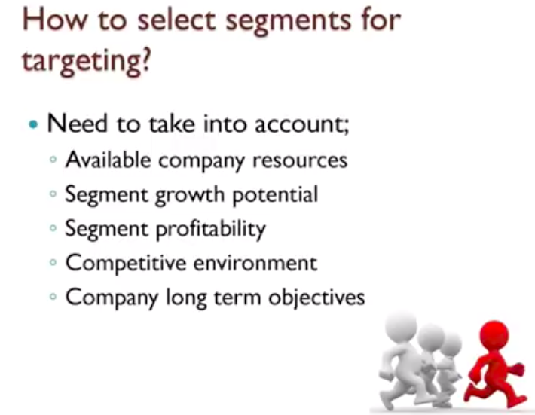

Slide 18
Market Targeting Strategies
There are three basic types of strategies:
Undifferentiated
Multisegment (Differentiated)
Concentration (Niche)

Slide 19
Positioning
Deciding how the firm wants the company and its brands to be perceived and evaluated by target markets
Differentiating the product from other products of the firm or its competition
Notes:
Once marketers have segmented the market and selected the target, the product or service needs to be properly “positioned.”
What does that mean?
Examples:
Deer Valley ski area in Utah decided to target skiers who wanted a hassle-free experience. They created a “valet ski service” and other amenities that make skiing more convenient
Carnival Cruise Lines, with its less expensive “fun ships,” targets a younger crowd than Royal Caribbean, which emphasizes superior service; Disney targets families

Slide 20
Positioning complements and is an integral part of the company’s segmentation strategy and selection of target markets
The same product can be positioned differently to different market segments
The result of successful positioning is a distinctive brand image on which consumers rely in making product choices

Slide 21
The Segmentation Process
Step 0: Identify your passions
E.g., Technology (i.e., expertise) & Education (i.e., domain/market)
Step 1: Start with a “generic” idea
E.g., I want to improve education through technology
Step 2: Identify potential “industries” of your selected domain
E.g., Universities, schools, centers, etc.,
Step 3: Identify all “end-users” in your industries
End-users are potential people who will use your potential product
E.g., Teachers, Students, Administrators, Parents, etc.,

Slide 22
The Segmentation Process
Step 3 (Cont’d): Identify all “end-users” in your industries
End-users are not necessarily “economic buyers”
E.g., Schools do not use course or advising systems, but teachers do
Step 4: Identify different “tasks” your end-users perform
E.g., Teachers teach, grade, advise, etc.,
Step 5: Identify different “specialties” of your end-users
...
You can follow
any logical order
and go as deep as you like

Slide 23
Example
Improve Education through Technology
Generic Idea
Universities
Schools
….
Education Centers
Industries
Students
Professors
….
Administrators
End-Users
Business
Computer Science
….
Sociology
Specialties
Teaching
Grading
….
Advising
Tasks
.
.
.

Slide 24
A Two-Stage Approach in Business Markets
Macro-Segments:
First stage/rough cut
Industry/application
Firm size
Micro-Segments:
Second-stage/fine cut
Different customer needs, wants, values within macro-segment
Notes:
5
5

Slide 25
Relevant Segmentation Descriptor
Variable A: Climatic Region
1. Snow Belt
2. Moderate Belt
3. Sun Belt
Fraction of Customers
Segment 1
Segment 2
Segment 3
0
100%
Likelihood of Purchasing Solar Water Heater (a)
Notes:
6
6

Slide 26
Irrelevant Segmentation Descriptor
Variable B: Education
1. Low Education
2. Moderate Education
3. High Education
Fraction of Customers
Segment 1
Segment 2
Segment 3
0
100%
Likelihood of Purchasing Solar Water Heater (b)
Notes:
7
7

Slide 27
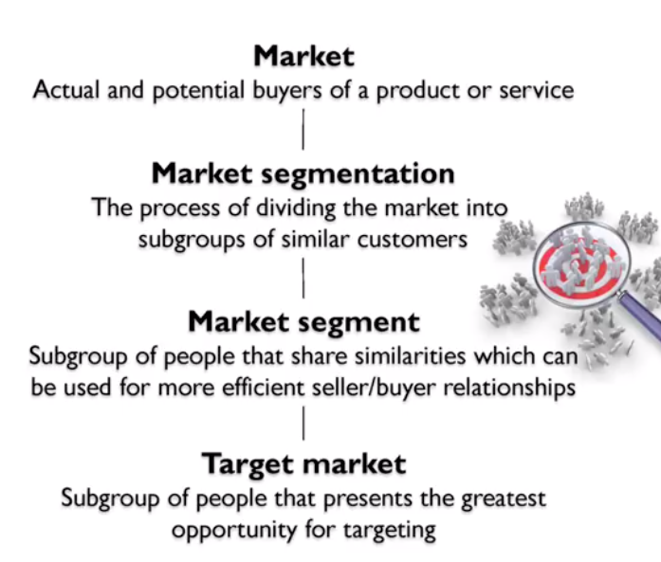

Slide 28
